Slide 1


Slide 2











IDEA
NOVEL
COMMUNICATIVE
Grapevine is a new idea that provides
greater possibilities for employees
Post about experiences with certain jobs
and who they might be fit for
FIRST-HAND
REVOLUTIONARY
Gives prospective employees information
from those on the front line
Grapevine has the ability to completely
redefine searching for a job

Slide 3

DESIGN
TAILORED
Sought feedback after initial model
in order to tailor app to audience
SAFE
The app is built with the ability to
change name for anonymity
MISSION
CONDENSED
Built to keep a singular focus, never
losing sight of our mission
Built with a condensed, self-contained,
”Gateway Model"

Slide 4

DEMONSTRATION

Slide 5
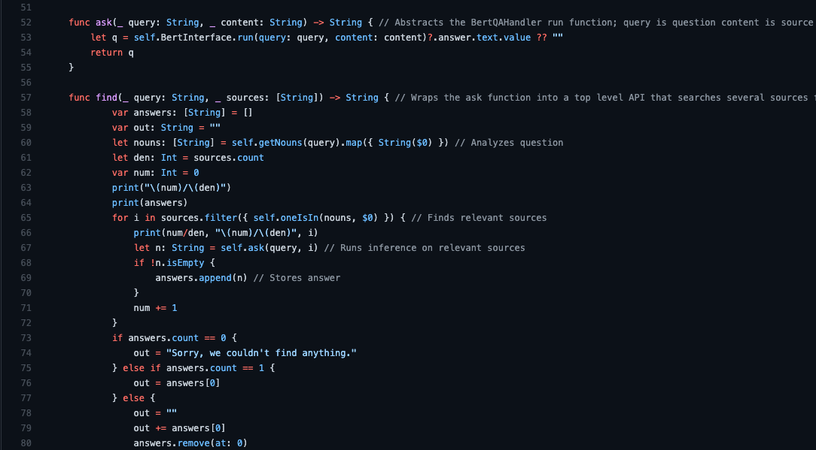
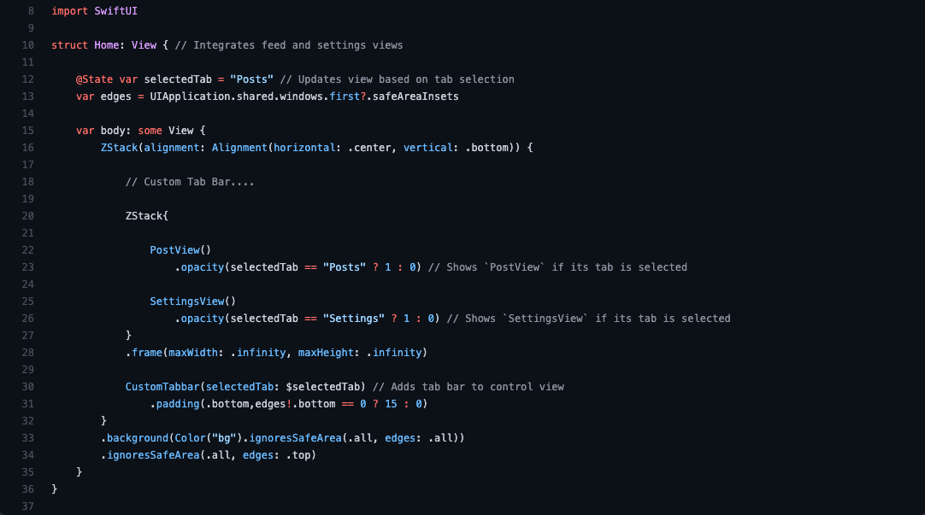

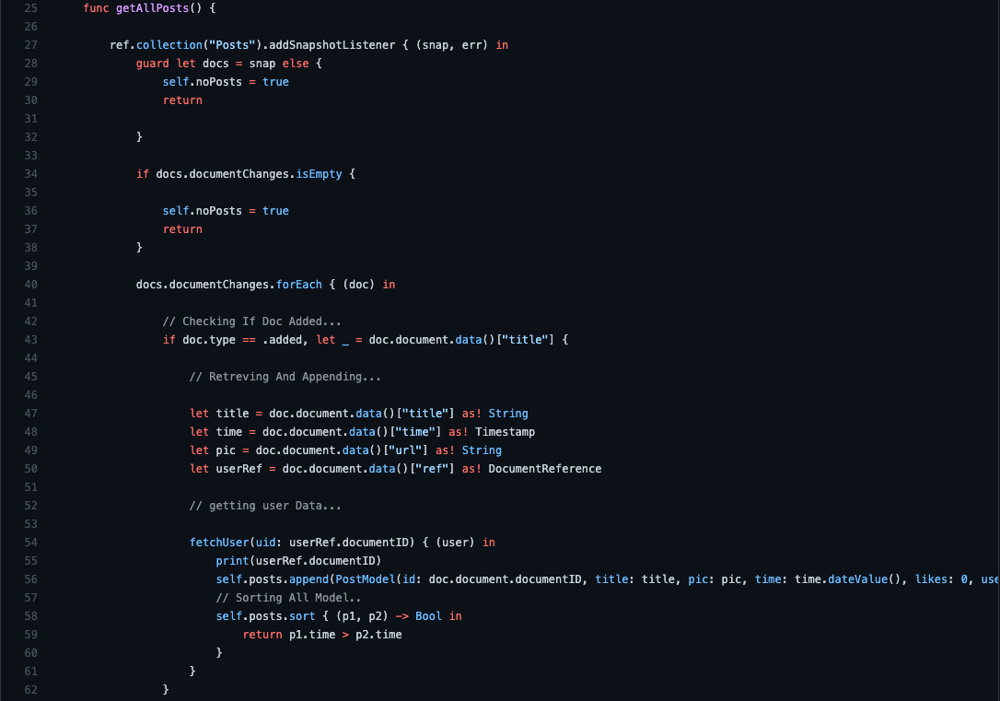
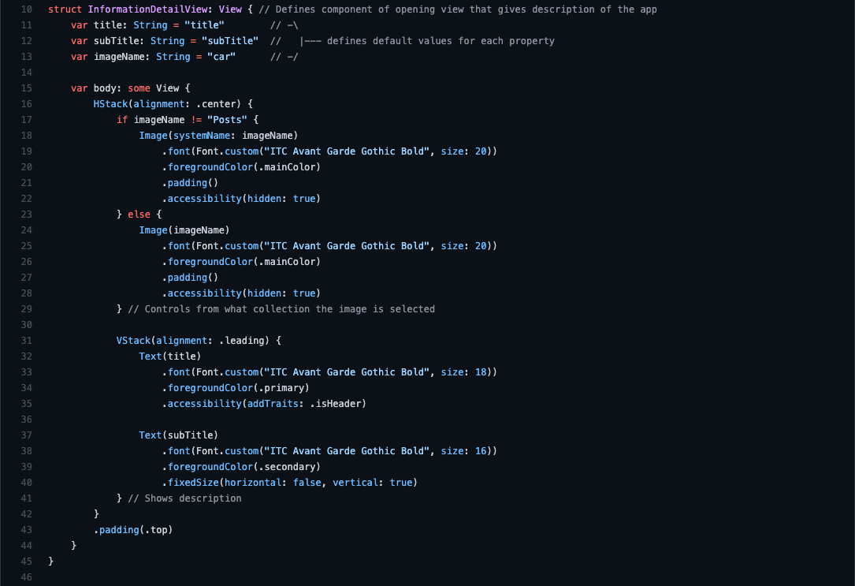
DEVELOPMENT
SWIFTUI
BERT QA
Interface built with Apple’s beautiful
SwiftUI framework
Built in AI system responds to questions
asked and answered with natural language
STACKING
DATABASE
Layout uses various stacking methods
consistently for familiar design
Stores data in Firebase for easy
retrieval and moderation

Slide 6
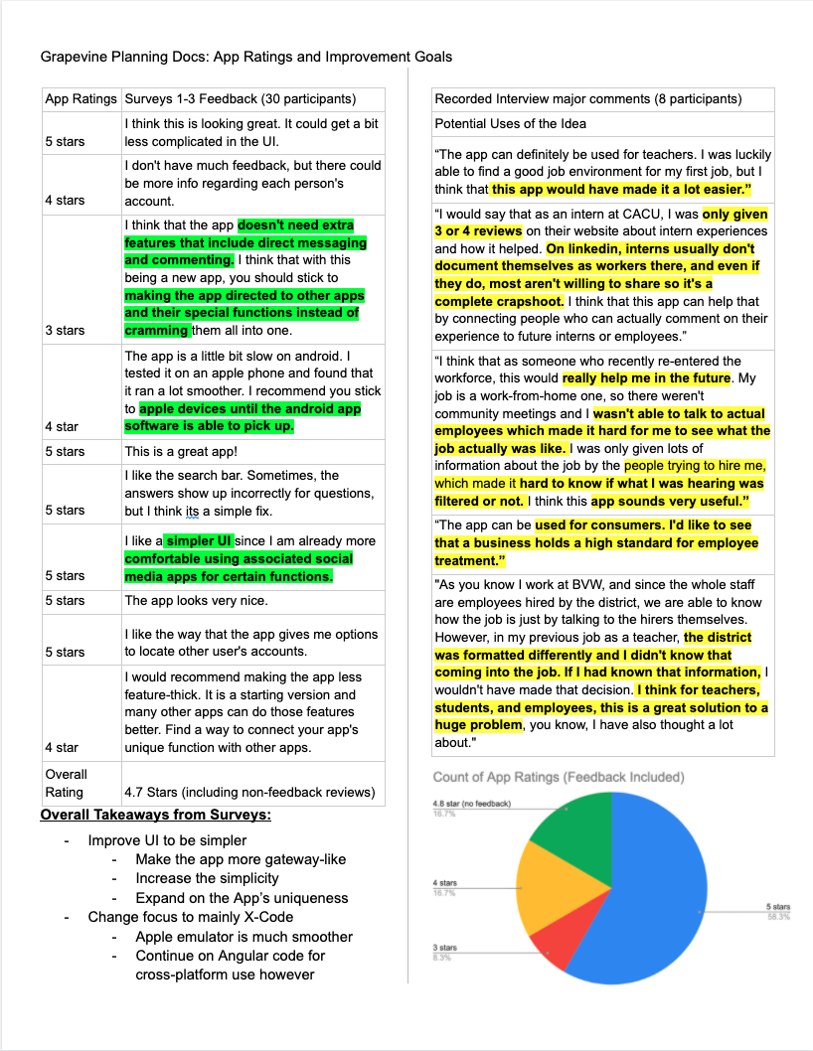
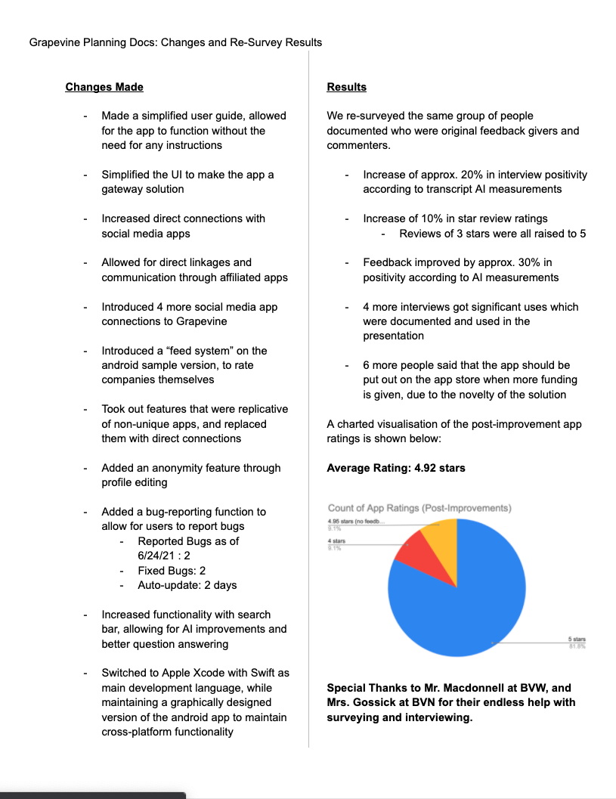


OPTIMIZATION
FINE-TUNED
SURVEY DATA AND
IMPROVEMENTS
Perfected based on user
satisfaction statistics
CONSISTENT
App design consistent
and intuitive
APP LAYOUT

